Slide 1

Multi Camera Tracking Project
Spring 2025 – Biweekly progress

Slide 2
Agenda
Objective
Recap
Current progress
Dataset description
Results
Conclusion
Next steps

Slide 3
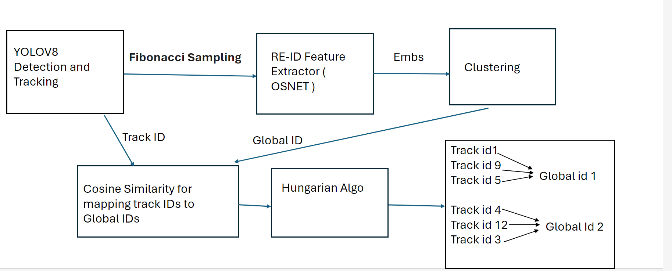
Objective
Project Goal : Developing a robust foundational Mutli camera tracking model , with a focus on person re-identification(Re-ID) tasks for this semester.

Slide 4
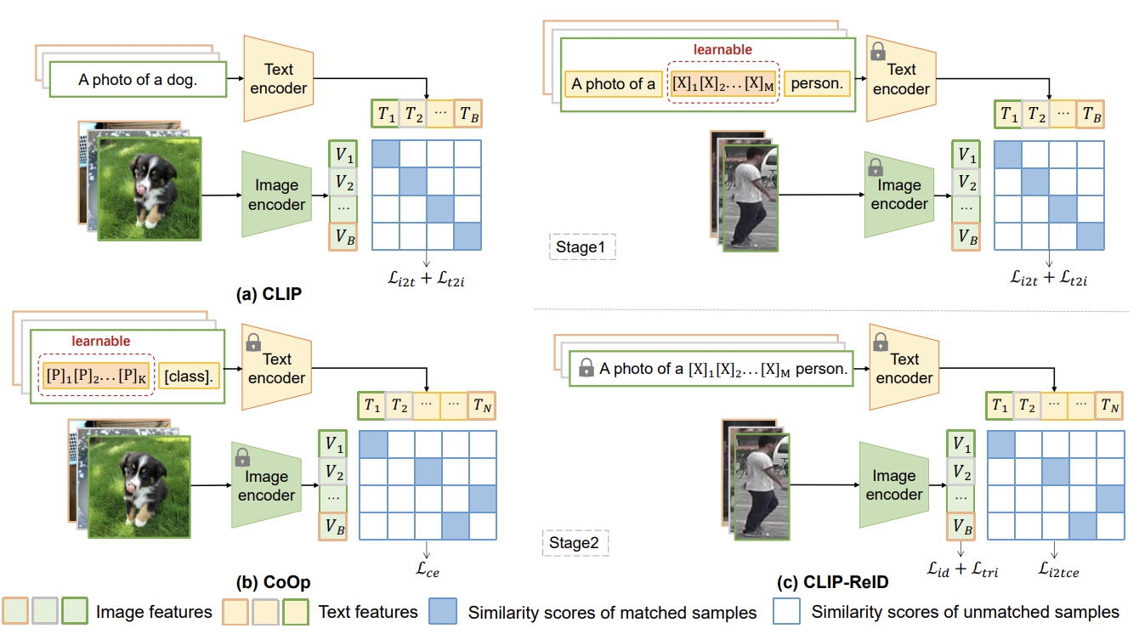
Recap – Literature Review on CLIP-ReID
Stage 1: Learnable Text Token Optimization
Fixed image and text encoders
Optimization of learnable text tokens
Contrastive loss similar to CLIP
Stage 2: Image Encoder Fine-tuning
Fixed text tokens and text encoder
Fine-tuning of image encoder
ID loss and triplet loss
Cross-modality image-to-text cross-entropy loss

Slide 5
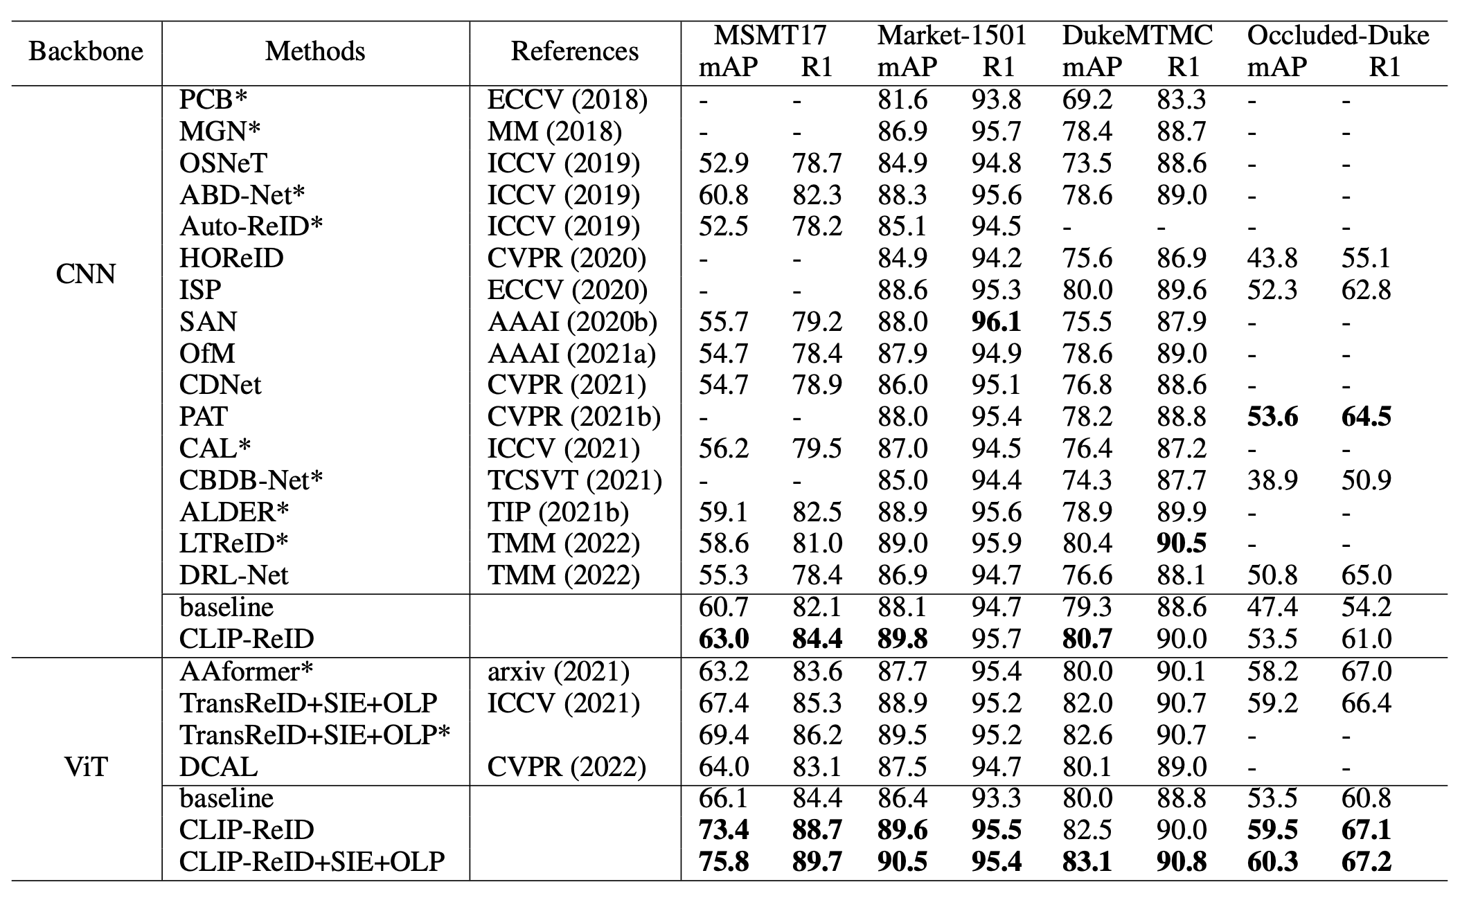
CLIP-ReID – State-of-the-art Comparison
43% in mAP
14% R1(rank1 accuracy)

Slide 6
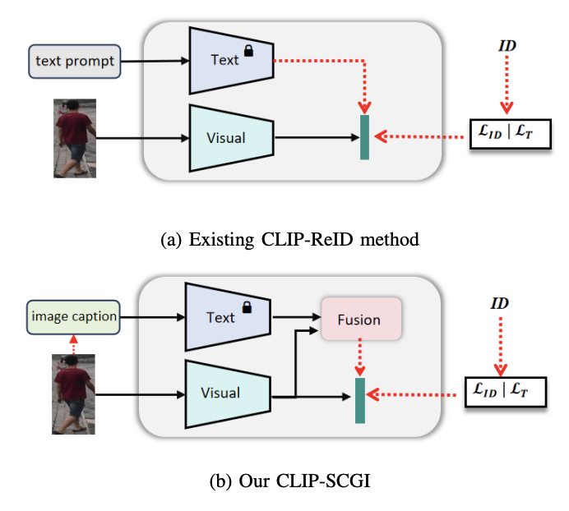
Recap – Literature Review on CLIP-SCGI
Problem: CLIP-ReID uses predefined ID tokens along with simple text prompts.
Absence of concrete descriptions that capture key semantic attributes such as gender, clothing, and age. Solution :
Leverage existing image captioning models(LLaVA) to generate pseudo captions for person images, to boost person re-identification using Vision language models (CLIP)
Introduce Caption guided inversion and Fusion module
CLIP-ReID
CLIP-SCGI
Notes:
One of recent CLIP based method (CLIP-SCGI) has shown using synthetic captions instead of static text to all the person ID.
CLIP-SCGI uses image captioner LLaVA (A large language vision model) to generate person specific captions.

Slide 7
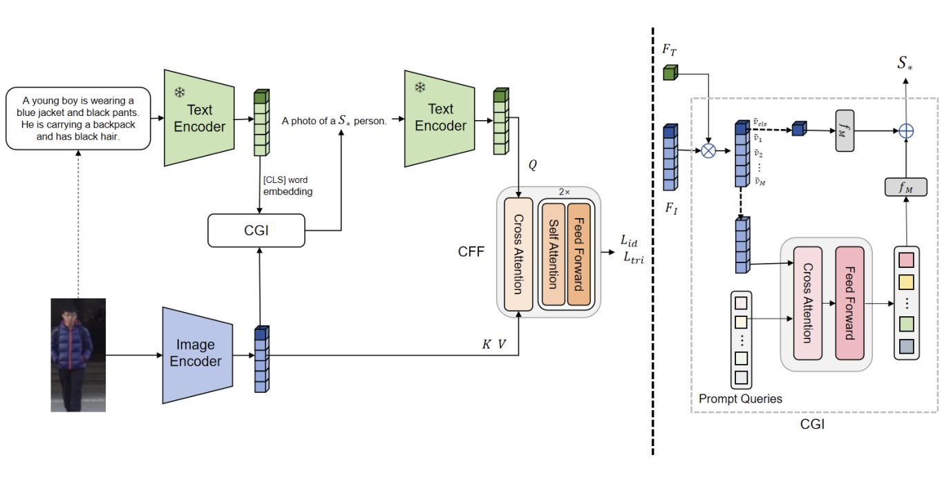
CLIP-SGCI :Methodology
On top of CLIP-ReID , CLIP-SCGI uses Caption Guided inversion(CGI) and Cross Feature Fusion(CFF) module
In Caption Guided Inversion , semantic attributes from images are converted into pseudo-word tokens guided through text descriptions.
Cross attention is performed between extracted features , guiding the model to focus on relevant regions.
The objective function remains same as CLIP-ReID (ID loss + Triplet loss + contrastive loss)

Slide 8
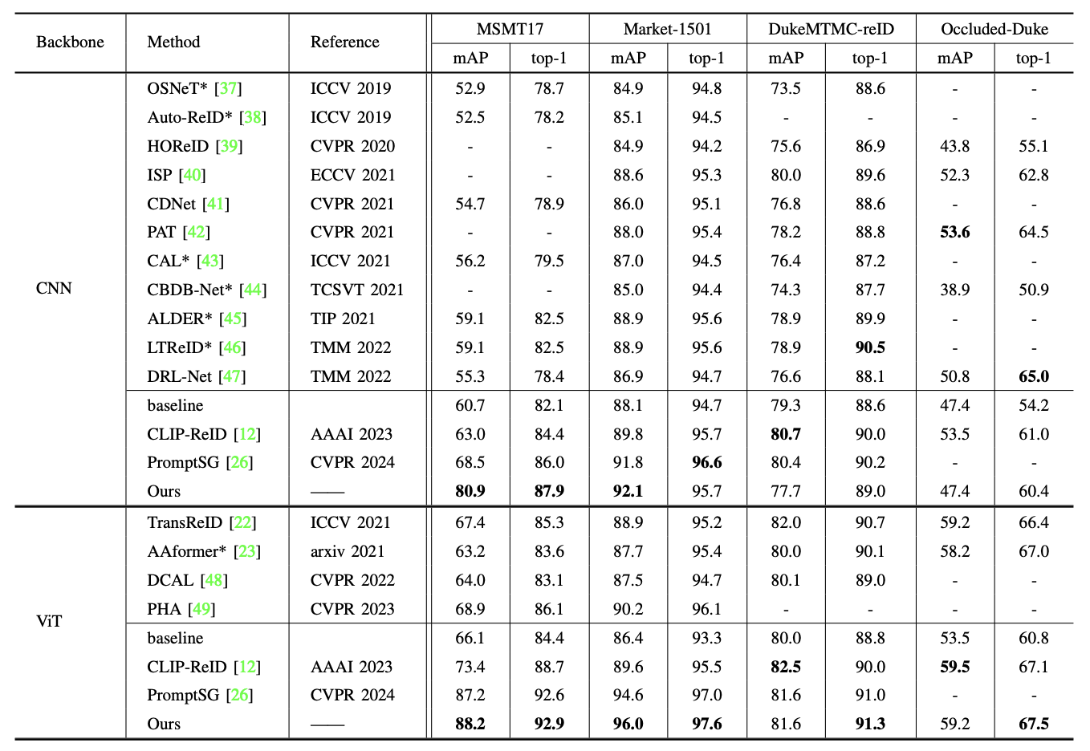
CLIP-SCGI – State-of-the-art Comparison
CLIP-SCGI has 26% higher parameters than CLIP-ReID
No increase in training time for one-stage approach compared to the two-stage CLIP-ReID.
Recap – Literature Review on CLIP-SCGI​

Slide 9
CLIP-SCGI
Challenges :
Open-source implementation is not available
Develop the modules from scratch which is time expensive.
Overhead of extracting synthetic captions using Large Language models.
Based on the observations from CLIP-ReID results , CLIP-SCGI can be considered for future work

Slide 10
Current Progress
Setup of CLIP-ReID codebase
Training of CLIP-ReID and OSNeT on :
Market-1501
Lowe's in-house ReID dataset
Qualitative and Quantitative comparison of CLIP-ReID and OSNeT on both datasets.
Resolved CLIP-ReID issues including model downloads and system dependencies(Turtle GUI)

Slide 11
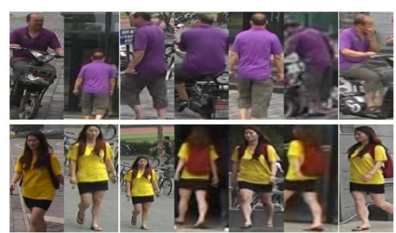
Dataset overview : Market-1501
A Large-scale public benchmark dataset for person re-identification tasks
This dataset consists of 1501 identities.
Split | IDs | Images | Cameras
Train | 751 | 12936 | 6
Query | 750 | 3368 | 6
Gallery | 751 | 15913 | 6
Test set
Dataset statistics
Each identity is present in atleast 2 cameras

Slide 12
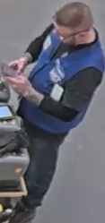
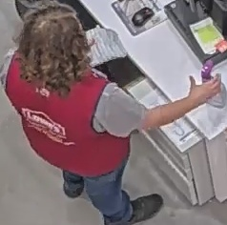


Dataset overview : Lowe's Re-ID Data
Train set examples
This dataset consists of 1022 identities.
Split | IDs | Images | Cameras
Train | 688 | 13615 | 1
Query | 466 | 3612 | 1
Gallery | 680 | 13625 | 1
Test set examples​
Test set
Dataset statistics
Each identity is across only one camera.

Slide 13
Experiments : Re-ID Evaluation workflow
Extract features for all the query and gallery images.
Apply L2 Normalization to feature vector.
Compute Euclidean distance between query and gallery features.
Generate a distance matrix ; Rank gallery images in ascending order.
Evalutation metrics :
CMC curve Assess matching probability at various ranks(Rank-1 Accuracy)
Mean Average Precision measures the retrival performance
Key : For each query identity, its gallery images from the same camera view are discarded

Slide 14
Experiments : Quantitative Results
Performance comparison of CLIP-ReID & OSNeT on Market-1501 Dataset
Method | Epochs | mAP | Top-1 Accuracy
OSNeT | 60 | 78.3 | 93.8%
OSNeT | 250 | 85.3% | 93.8%
CLIP-ReID | 60 | 89.8% | 95.3%
CLIP-ReID+SIE+OLP | 60 | 96.6% | 99.9%
13.2% mAP ,
6.5% Top-1 Accuracy

Slide 15
Experiments: Quantitative Results
Performance comparison of CLIP-ReID & OSNeT on Lowe's Dataset ​
Method | Epochs | mAP | Top-1 Accuracy
OSNET | 50 | 95.8% | 98.3%
CLIP-ReID | 60 | 96.6% | 98.3%
CLIP-ReID+SIE+OLP | 60 | 96.6% | 98.2%
Both methods perform in similar for the below reasons :
Unlike Market-1501 , Lowe's data has common identities in both train and test split.
This dataset lacks multi camera and multi view samples.
In Traditional ReID evaluations , Gallery samples from same person and camera are not considered. However , we evaluate on same samples.

Slide 16
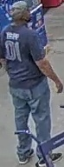
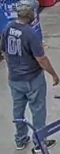


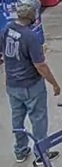
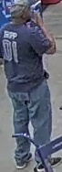

Lowe's Data : Query & Gallery Examples
Query:
Train samples :
Train set and Test set has Similar Identities
No Multi camera samples
Gallery:
As the Query is similar to Gallery images , their Feature Norms are closer and Hence, Always Rank as Top-1.

Slide 17

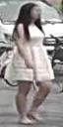
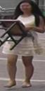
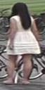

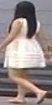
Market –1501 Dataset : Query & Gallery Examples
Query:
Train spilt does not contain this sample
Cross Camera sample between Query and Gallery samples
​
Gallery:

Slide 18
CLIP-ReID– Takeaways
Quantitative results on Market-1501 suggest that CLIP-ReID is better than OSNeT.
CLIP-ReID requires less training than OSNeT(in terms of epochs) due to CLIP's pretraining.
Unlike to this trend , performance on Lowe's data is almost similar due to below limitations. So irrespective of the method , unless the dataset is diverse the performance remains same.
Limitations :
Query and Gallery images belong to same camera
Train and Test split has common images.
Lack of multi camera image samples.

Slide 19
Conclusion
Goal : To Enhance person re-identification task of Multi camera tracking framework.
Explored state-of-the-art person Re-ID methods CLIP-ReID , CLIP-SCGI
Conducted experiments on Market-1501, Lowe's datasets using CLIP-ReID, OSNeT.
CLIP-ReID outperforms OSNeT(our baseline) by 13.2% , 6% in mAP , rank-1 accuracy respectively on Market-1501.
In Contrast to Market-1501 data, both approaches demonstrate similar performance on Lowe's data due to several dataset limitations.

Slide 20
Next Steps
​
Evaluate CLIP-ReID on Lowe's data which contains multi camera data.
Extract CLIP-ReID features and replace them with OSNeT features in existing Multi camera tracking pipeline
Perform end-to-end tracking after replacing CLIP-ReID component.
Conduct literature study :
Multi camera tracking approach BEV-SUSHI: Multi-Target Multi-Camera 3D Detection and Tracking in Bird’s-Eye View from Nvidia
Generate multi-view human data to enhance training using Pippo: High-Resolution Multi-View Humans from a Single Image
​

Slide 21
Multi Camera Tracking Project
Spring 2025 – weekly progress - Feb 27

Slide 22
Agenda
Objective
Recap
Current progress
Experimental Discussion (CLIP-ReID, OSNeT)
Literature study on Pippo
Conclusion
Next steps

Slide 23
Objective
Project Goal : Developing a robust foundational Mutli camera tracking model , with a focus on person re-identification(Re-ID) tasks for this semester.

Slide 24
Recap
Discussed state-of-the-art person re-identification approaches like CLIP-ReID,CLIP-SCGI
Setup CLIP-ReID codebase and resolved issues (Turtle GUI and model downloads).
Training of CLIP-ReID and OSNeT on :
Market-1501
Lowe's in-house ReID dataset
Qualitative and Quantitative comparison of CLIP-ReID and OSNeT on both datasets.

Slide 25
Dataset overview : Market-1501 & Lowe's
A Large-scale public benchmark dataset for person re-identification tasks
This dataset consists of 1501 identities.
This dataset consists of 1022 identities.
Split | IDs | Images | Cameras
Train | 751 | 12936 | 6
Query | 750 | 3368 | 6
Gallery | 751 | 15913 | 6
Split | IDs | Images | Cameras
Train | 688 | 13615 | 1
Query | 466 | 3612 | 1
Gallery | 680 | 13625 | 1
Test set
Market-1501 statistics
Lowe's Data statistics
Each identity is present in atleast 2 cameras
Each identity is across only one camera.

Slide 26
Experiments : Quantitative Results
Market-1501 Dataset
Lowe's Dataset ​
Method | Epochs | mAP | Top-1 Accuracy
OSNeT | 60 | 78.3 | 93.8%
OSNeT | 250 | 85.3% | 93.8%
CLIP-ReID | 60 | 89.8% | 95.3%
CLIP-ReID+SIE+OLP | 60 | 96.6% | 99.9%
Method | Epochs | mAP | Top-1 Accuracy
OSNET | 50 | 95.8% | 98.3%
CLIP-ReID | 60 | 96.6% | 98.3%
CLIP-ReID+SIE+OLP | 60 | 96.6% | 98.2%
13.2% mAP ,
6.5% Top-1 Accuracy
No change observed in the metrics. Due to Dataset limitations

Slide 27
Lowe's Data Overview & Limitations
Query:
Train samples :
Train set and Test set has Similar Identities
No Multi camera samples
Gallery:
As the Query is similar to Gallery images , their Feature Norms are closer and Hence, Always Rank as Top-1.

Slide 28
Market –1501 Dataset : Query & Gallery Examples
Query:
Train spilt does not contain this sample
Cross Camera sample between Query and Gallery samples
​
Gallery:

Slide 29
Current Progress
To better understand the effectiveness of CLIP-ReID and OSNeT, we performed cross-setting experiments.
Quantitative analysis of cross-setting evaluations for both .
Conducted literature study on generating multi-view synthetic data.
Familiarized with Pippo ,latest multi-view video generation model from single human image as input.

Slide 30
Cross setting Evaluation
Trained on Market-1501 Train split and evaluated on Lowe's Data(Test Split)
Method | Epochs | Model Param | mAP | Top-1 Accuracy
OSNeT | 50 | 2M | 68.4 | 96.2%
OSNeT | 150 | 2M | 70.2 | 96.7%
CLIP-ReID | 60 | 89M | 80.4 | 96.7%
CLIP-ReID+SIE+OLP | 60 | 89M | 80.7 | 96.7%
17% increase in mAP
CLIP-ReID outperforms OSNet in mAP, suggesting better retrieval performance and better feature discrimination.
OSNeT struggles with domain shift, the learned local features may be dataset specific.
Notes:
HIgher maP means More precise retrival of correct matches across frame in multi-camera tracking.

Slide 31
CLIP-ReID or OSNeT
CLIP-ReID leverages a richer embedding space that captures more semantic person information beyond low level CNN features.
In cases where a person's appearance changes due to lighting , pose or occlusion, these features can help better identifying person.
Better ReID features benefits tracking , More precise retrieval of correct matches across frames in multi camera tracking.
More discriminative features mean fewer ID switches in tracking algorithms.
In Conclusion , CLIP-ReID's stronger generalization across domains, robust person re-identification features would improve tracking performance.
Hence, these observations suggest CLIP-ReID is better than OSNeT
Notes:
HIgher maP means More precise retrival of correct matches across frame in multi-camera tracking.

Slide 32
Potential ways to improve CLIP-ReID
Could we further enhance the performance of CLIP-ReID by using CLIP-SCGI?
Rather than relying on learnable text tokens , what if we generate synthetic captions from LLaVA for better semantic understanding.
Notes:
HIgher maP means More precise retrival of correct matches across frame in multi-camera tracking.

Slide 33
Pippo: High-Resolution Multi-View Humans from a Single Image
Authors: Yash Kant, Ethan Weber, Jin Kyu Kim , Rawal Khirodkar , Su Zhaoen, Julieta Martinez , Igor Gilitschenski ,
Shunsuke Saito , Timur Bagautdino
Source : pippo.pdf

Slide 34
Pippo – Problem & Motivation
Challenges in Multi-View Human Generation
Creating a realistic multi-view images is difficult.
Existing approaches rely on expensive 3D captures or predefined models.
Pippo's introduction
Uses a data-driven approach to synthesize consistent multi-view images.
Requires only a single image without parametric models.

Slide 35
Pippo – Background and Related work
Multi-View Human Generation
Traditional methods use parameteric 3D models or explicit mesh reconstruction.
Neural rendering approaches, such as NeRF, struggle with limited input data. ​
Diffusion Transformer
Recent works use diffusion models for image synthesis but lack structured multi-view consistency.
Pippo introduces spatial conditioning and large-scale training for high-resolution multi-view generation. ​

Slide 36
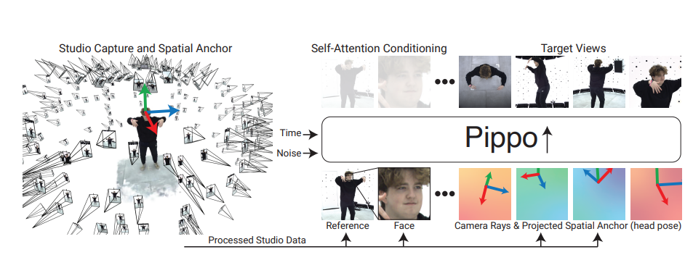
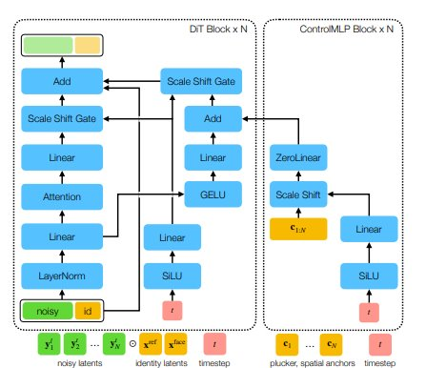
Pippo – Pipeline overview

Slide 37
Pippo's Approach
Multi stage Training pipeline
Pre-training : Learns generalizable features from 3B in the wild human images.
Mid-training :
Learns multi-view generation from studio-captured datasets.
Train model at low-resolution of 128 × 128 to denoise 48 target views with coarse camera control (no pixel-aligned spatial control).
Post-training:
Enhances 3D consistency using Spatial Anchor & plucker rays.
Train at a high-resolution of 1024 × 1024 to denoise 1 − 3 target views with spatial control injected via ControlMLP layers
Diffusion Transformer(DiT) Model:
Generates multiple views simultaneously with high fidelity

Slide 38
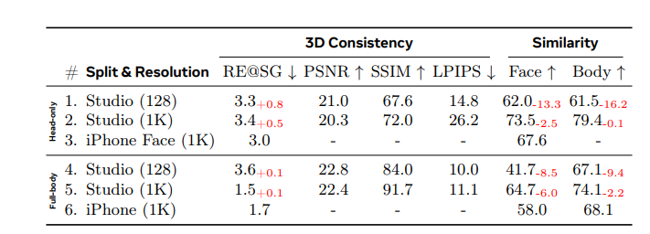
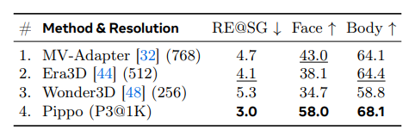
Pippo – Experimental results
Training Data : Humans-3B , High quality head and full body
Test Data : Real world images from iphone.
Evaluation metrics :
3D Consistency like reprojection error(RE@SG) , PSNR , SSIM , LPIPS
Identity evaluation using cosine similarity of features from FaceNet for face , CLIP features for body
State-of-the-art-comparison
Unseen studio and iphone data

Slide 39
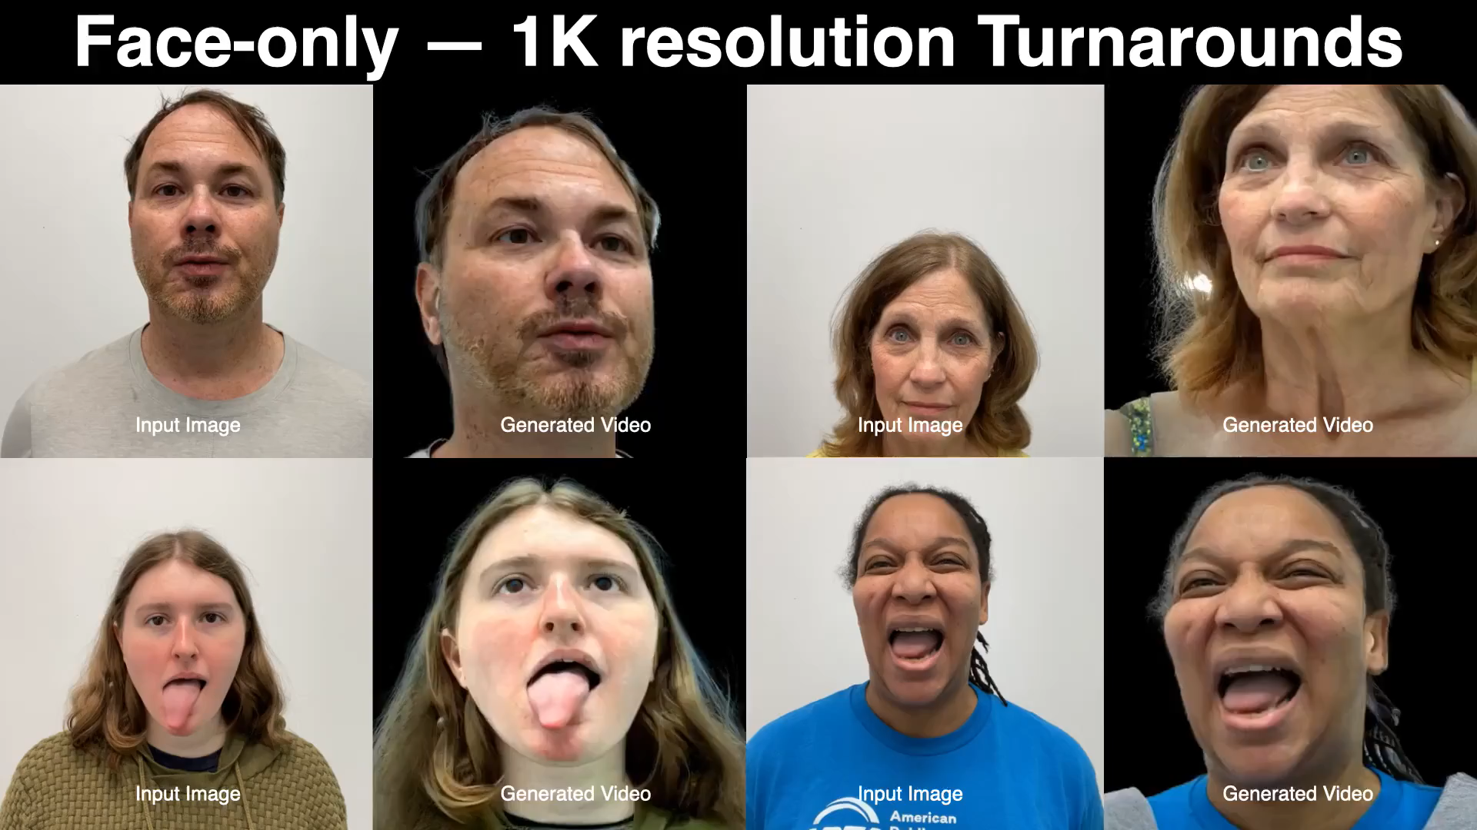
Qualitative examples of Pippo

Slide 40
How can pippo be useful for Lowe's data?
Generate missing views for multi-camera tracking.
For instance , a camera may have one or two views
By creating turnaround views, we can get more robust features of an individual.
Few scenarios where pippo can be applied :
Occlusions
Missing views of same person.
In scenes where some body parts of an individual are missing.

Slide 41
Conclusion
Goal : To Enhance person re-identification task of Multi camera tracking framework.
Conducted experiments on Market-1501, Lowe's datasets using CLIP-ReID, OSNeT.
From initial observations , both approaches demonstrate similar performance on Lowe's data due to several dataset limitations.
Based on the cross setting evaluations, it is evident that CLIP-ReID is better than OSNeT.
With the focus of improving training data, we can leverage pippo capabilities to generate multi-view turnaround videos.

Slide 42
Next Steps
​
Evaluate CLIP-ReID on Lowe's data which contains multi camera data(New Dataset).
Extract CLIP-ReID features and replace them with OSNeT features in existing Multi camera tracking pipeline
Perform end-to-end tracking after replacing CLIP-ReID component.
Utilize Pippo which generates multi-view human turn around synthetic video to enhance ReID task and further tracking.
​

Slide 43
Multi Camera Tracking Project
Spring 2025 –Bi weekly progress - Mar 6

Slide 44
Agenda
Objective
Recap
Current progress
Experimental Discussion
New Dataset
Conclusion
Next steps

Slide 45
Objective
Project Goal : Developing a robust foundational Mutli camera tracking model , with a focus on person re-identification(Re-ID) tasks for this semester.

Slide 46
Recap
Discussed state-of-the-art person re-identification approaches like CLIP-ReID,CLIP-SCGI and Multi view video generation approach Pippo
Initial experiments with CLIP-ReID , OSNeT on :
Market-1501
Lowe's in-house ReID dataset
Quantitative comparison of CLIP-ReID and OSNeT on both datasets.
CLIP-ReID shows better results than OSNeT in Cross dataset evaluation.
Potential ways to improve CLIP-ReID

Slide 47
Dataset overview : Market-1501 & Lowe's Old ReID Dataset
A Large-scale public benchmark dataset for person re-identification tasks
This dataset consists of 1501 identities.
This dataset consists of 1022 identities.
Split | IDs | Images | Cameras
Train | 751 | 12936 | 6
Query | 750 | 3368 | 6
Gallery | 751 | 15913 | 6
Split | IDs | Images | Cameras
Train | 688 | 13615 | 1
Query | 466 | 3612 | 1
Gallery | 680 | 13625 | 1
Test set
Market-1501 statistics
Lowe's Data statistics
Each identity is present in atleast 2 cameras
Each identity is across only one camera.

Slide 48
Performance Comparison of Market-1501 & Lowe's Data
Market-1501 Dataset
Lowe's Dataset ​
Method | Epochs | mAP | Top-1 Accuracy
OSNeT | 60 | 78.3 | 93.8%
OSNeT | 250 | 85.3% | 93.8%
CLIP-ReID | 60 | 89.8% | 95.3%
CLIP-ReID+SIE+OLP | 60 | 96.6% | 99.9%
Method | Epochs | mAP | Top-1 Accuracy
OSNET | 50 | 95.8% | 98.3%
CLIP-ReID | 60 | 96.6% | 98.3%
CLIP-ReID+SIE+OLP | 60 | 96.6% | 98.2%
No change observed in the metrics. Due to Dataset limitations
13.2% mAP ,
6.5% Top-1 Accuracy
Train set and Test set has Similar Identities​
No Multi camera samples

Slide 49
Cross setting Evaluation
Trained on Market-1501 Train split and evaluated on Lowe's Data(Test Split)
Method | Epochs | Model Param | mAP | Top-1 Accuracy
OSNeT | 50 | 2M | 68.4 | 96.2%
OSNeT | 150 | 2M | 70.2 | 96.7%
CLIP-ReID | 60 | 89M | 80.4 | 96.7%
CLIP-ReID+SIE+OLP | 60 | 89M | 80.7 | 96.7%
17% increase in mAP
CLIP-ReID outperforms OSNet in mAP, suggesting better retrieval performance and better feature discrimination.
OSNeT struggles with domain shift, the learned local features may be dataset specific.
Notes:
HIgher maP means More precise retrival of correct matches across frame in multi-camera tracking.

Slide 50

Data Sample : Lowe's Data , Market-1501
Query:
Train samples :
Query:
Gallery:
Gallery:

Slide 51
Current Progress
Perform Analysis of New Lowe's Dataset.
Come up with ReID Dataset preparation workflow.
Implemented the pipeline to convert the raw videos into ReID data.
Dataset statistics like cameras, IDs , No of images, scenes.

Slide 52
New Lowe's dataset
Raw videos with 1920x1080p resolution of each 20 min of length
All the videos are annotated in MOT format with 10fps.
There are total of 47 videos across 16 scenes.
​

Slide 53
ReID Dataset Preparation pipeline
Extract frames from raw videos across all the cameras.
Person centric cropping using the MOT ground truth labels.
Generate Train, Query ,Gallery splits
Format generated dataset in Market-1501 style.

Slide 54
Example video from new Lowe's dataset
I will showcase a video here as an example that visualizes the tracks of multiple people.

Slide 55
Conclusion
Goal : To Enhance person re-identification task of Multi camera tracking framework.
Performed experiments on Market-1501, Lowe's datasets using CLIP-ReID, OSNeT.
Based on the cross setting evaluations, it is evident that CLIP-ReID is better than OSNeT.
Conducted Analysis on Newly collected Lowe's data from store 1573.
Proposed a dataset preparation pipeline to convert the available raw data to person re-id dataset.

Slide 56
Next Steps
​
Creation of ReID Dataset from the Newly Collected videos from Lowe's store 1573.
Perform data cleaning to ensure we have robust person reid data from multiple cameras.
Evaluate CLIP-ReID , OSNeT method on new reid data and observe the improvements.
Enhance the Utilize Pippo which generates multi-view human turn around synthetic video to enhance ReID task and further tracking.
​

